Slide 1
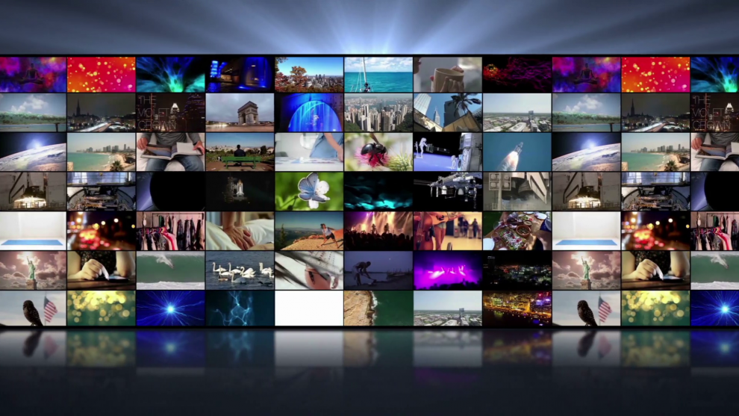
Engineering solutions for the Media Industry

Slide 2

Media Services - IBM Cloud Pak for Data
OTT Monitoring
Sales/ Advertising
Catalog
Enable monitoring of media platforms
Real time event feeds of media sessions
Enhance revenues by campaign optimization
Integration of campaigns on all channels
Operations can monitor service disruptions
Prediction of platform performance
Campaign performance prediction and optimization
Subscription
Viewership
Consumer behavior analytics
Analyze viewer behavior
Integration with third party data
Subscription Management
Quickly develop platform paywalls
Provide security and fraud prevention
Product metadata maintenance
Product management services
Syndicate product management

Slide 3
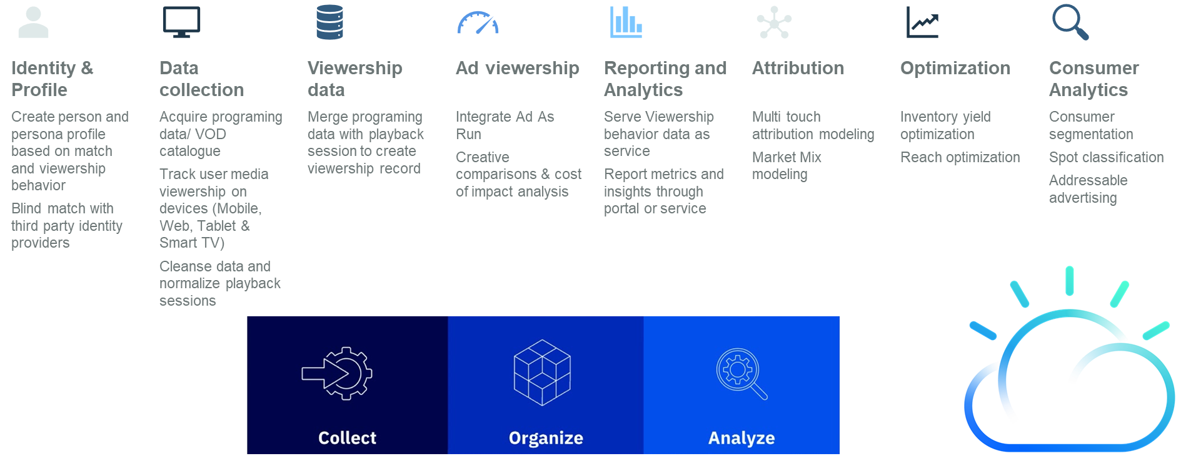
Multichannel Viewership Analytics - Cloud Pak for Data

Slide 4





Media Stakeholder Objectives
Function Objectives | Campaign ROI Achieve brand goals | Realize partnership value | Achieve sales numbers and growth | Product Improvements & Roadmap | Quality of Service Maximize ad revenues
Indicative Metrics | Budget Reach Frequency Impressions Conversions Clicks | Active users Content by geography revenue | Revenue Profit Sales by segments Sales by products | Bit rate Rebuffer rate Frames per second Availability Start up delay | Inventory yield Fill rate Abandonments Engagement Repeat viewership
Area of analysis | Audience Segmentation Impact Analysis Campaigns Conversions | Audience profile Content consumption Content profiling | Revenues Customers Inventory | Platform performance New features Capacity planning Platform robustness | Viewer behavior Inventory Video quality Ad fulfillment Creative quality
Advertisers
Partners
Sales
Product Engagement
Operations

Slide 5
AI /ML, Analytics Offerings for Media
Media Usecases
Advanced Advertising
AI/ML & Data Analytics
Quality of Experience
Personalization
PRODUCTS & SERVICES
Audience Targeting
Ad/purchase attribution
Audience Intelligence
Digital ad operations and campaign analysis
Platform Performance Monitoring
Prediction of platform performance
Content Intelligence
Content Ranking predictions
Game monetization analytics
Audience Exposure & Retention
Viewership Forecasting
Capacity Planning
Improve Quality of Experience
Content Automation
Clickstream Analytics data platform
Peak usage and demand forecasting
Content Recommen-dation
Spot Recommendations
Virtual A/ B testing scenarios
Content QA/QC
TECHNOLOGIES
Predictive Modeling
Time-series, classification, regression, anomaly detection, LR, Decision Trees, RF, SVM, XGB, CART, PCA, …
Deep Learning
Convolutional NN (CNN), Recurrent NN (RNN), LSTM, GRU, Generative Adversarial Networks (GAN), vision, sequence models
Natural Language Processing
Chatbots, Text classification, Entity extraction, sentiment analysis, topic modelling, Word2vec
Decision Making Reinforcement Learning
A-B testing, Contextual Multi-Armed Bandit (CMAB), Deep Q-Learning, Deep RL, Policy Gradient
Data Management
Cloud
Business Intelligence
Petabyte scale data lakes
Data Warehouses
Hadoop Ecosystem
Cloud Native, Hybrid Architectures
DevOps

Slide 6
Tavant Media Services & Solutions
Subscription & entitlement
Content/ Video Management
Rights Management
Program Guide
Metadata Management
Video streaming
Broadcast Operations
Measurement – Linear, Addressable, OTT, Digital
Audience Research and Segmentation
Attribution - Creative/ Channel/ Media
Viewership behavior modeling
Unified workflows
Inventory Management
Campaign Management
Optimization - Campaign and Yield
Reconciliation, Unified Invoicing and Billing
Mobility & Connected Device development
Connected TV
Gaming
Video Testing
User Experience
Content Mgt & Distribution
Advanced Advertising
Media Sales & Ad Ops
Platform Development
Data & Analytics
Data Engineering
AI& ML
Visualization
Data Quality
Horizontal Capabilities
Cloud
Quality Assurance
Managed Services
DevOps
UX/ UI
Tavant Proprietary & Confidential
Tavant Proprietary & Confidential

Slide 7
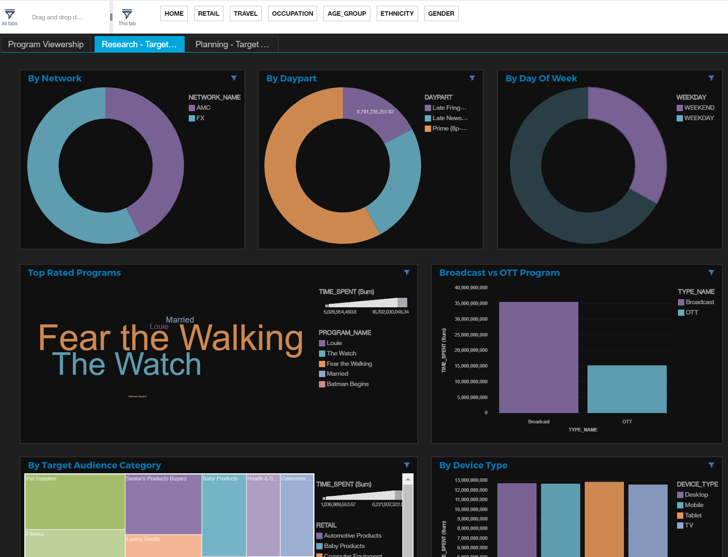
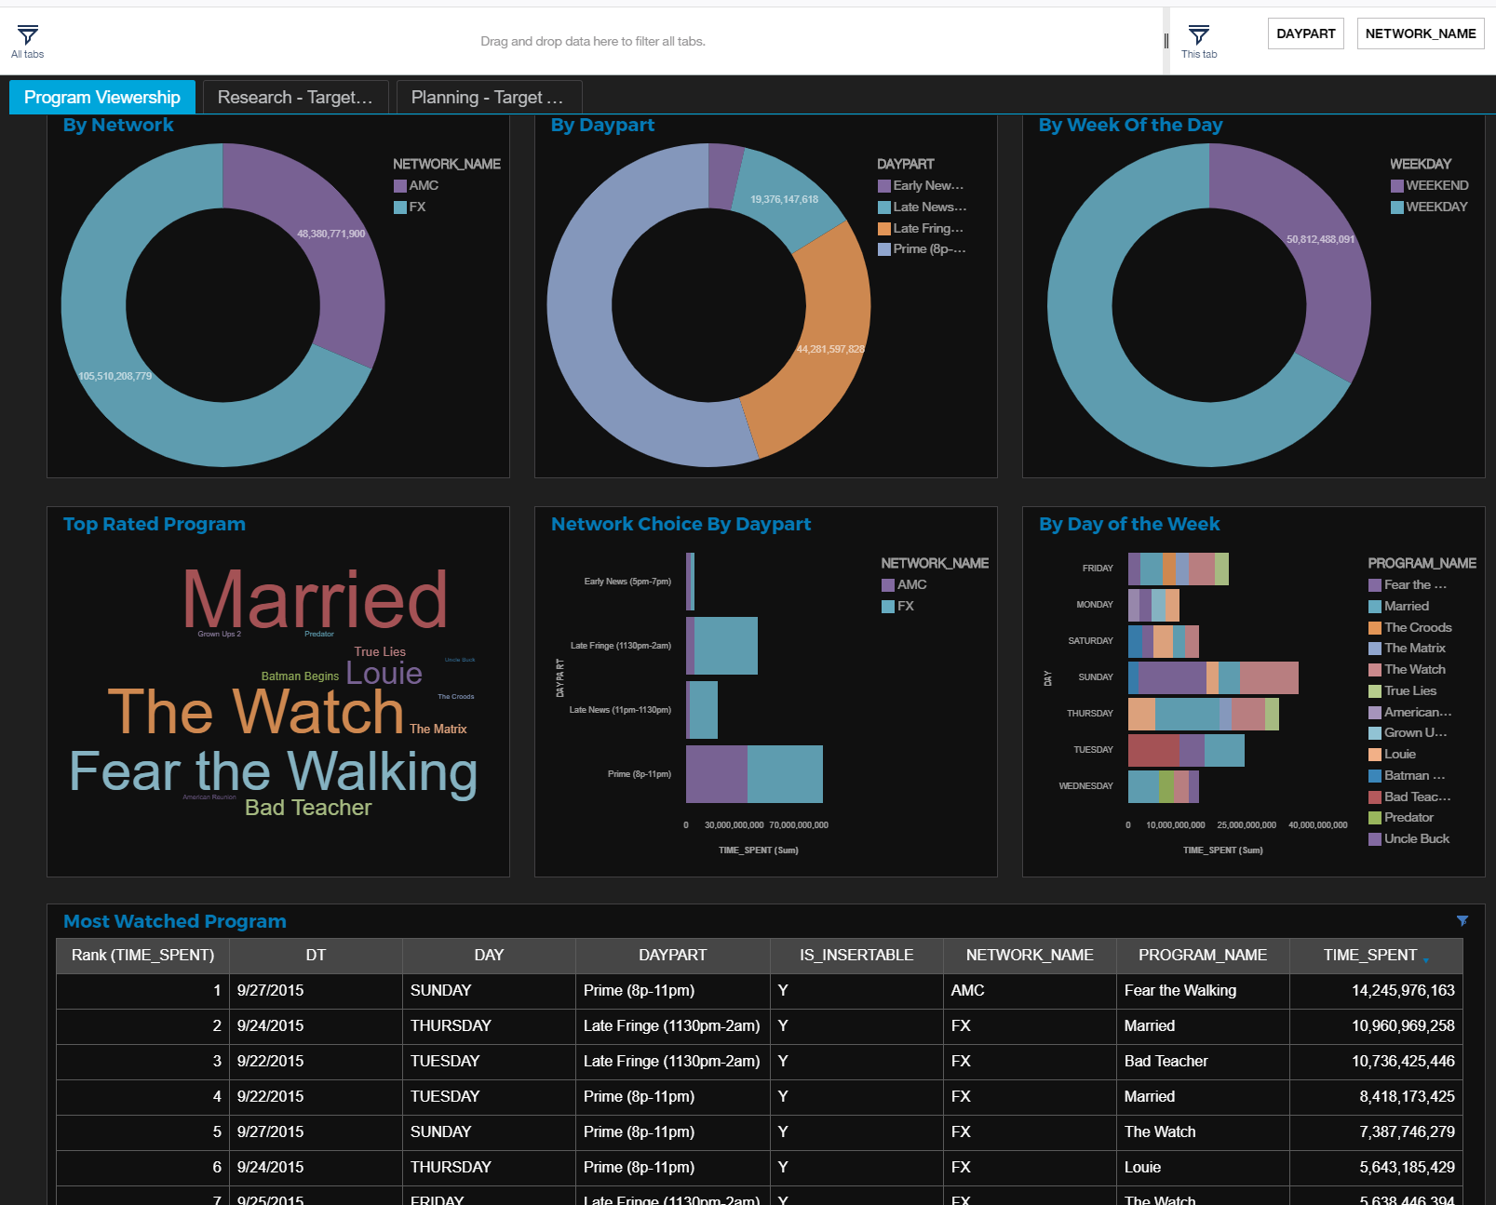
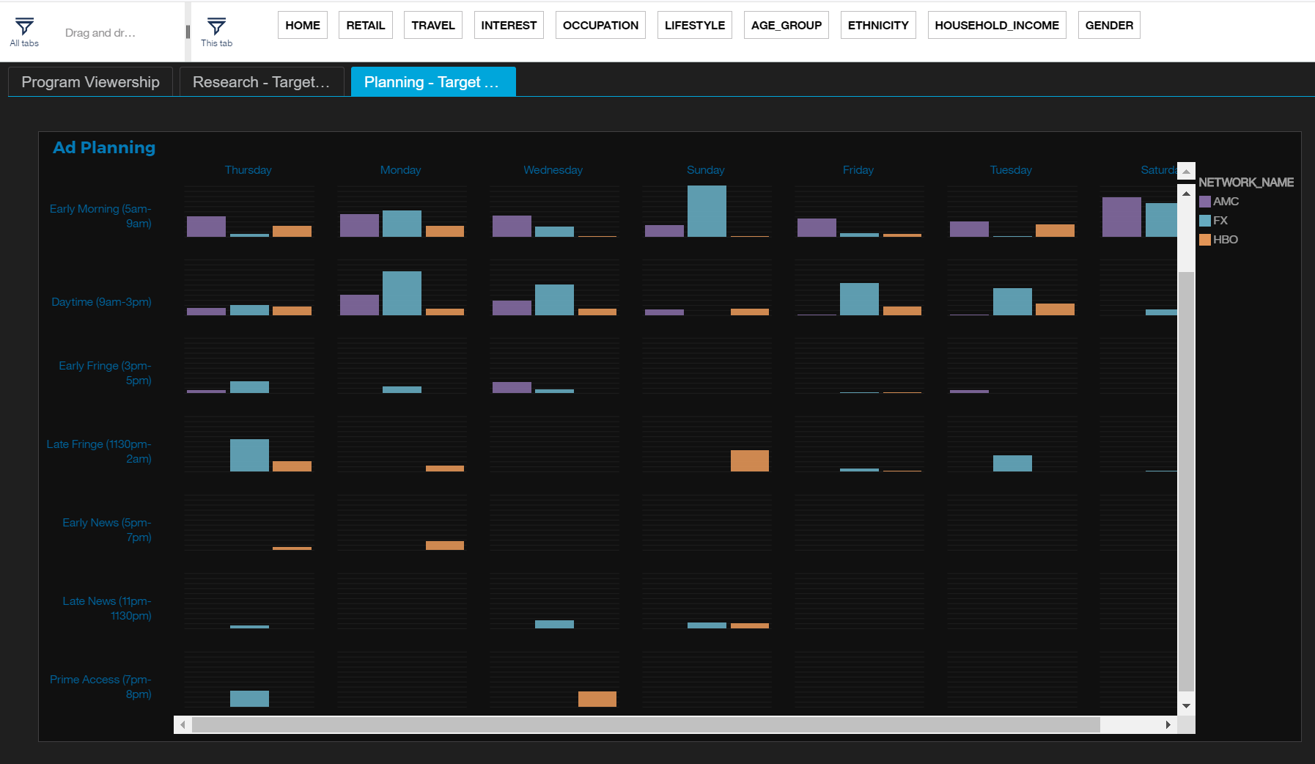
Viewership Reports Screenshots

Slide 8
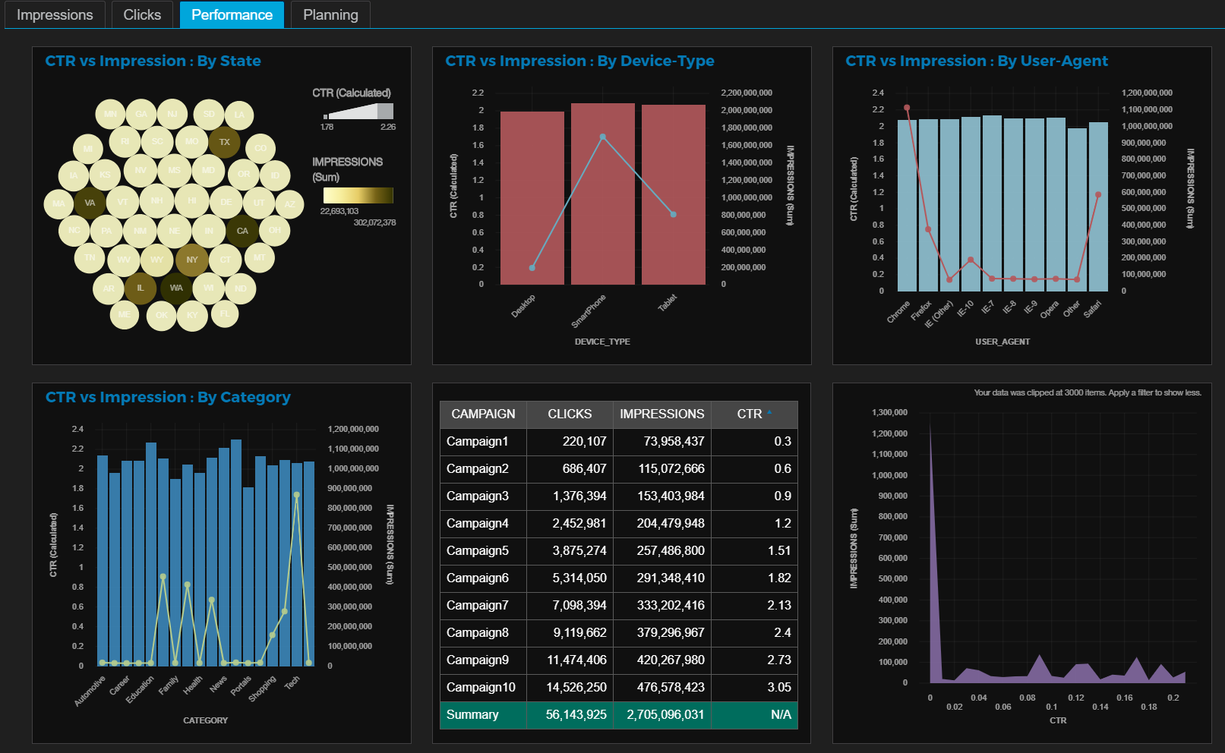
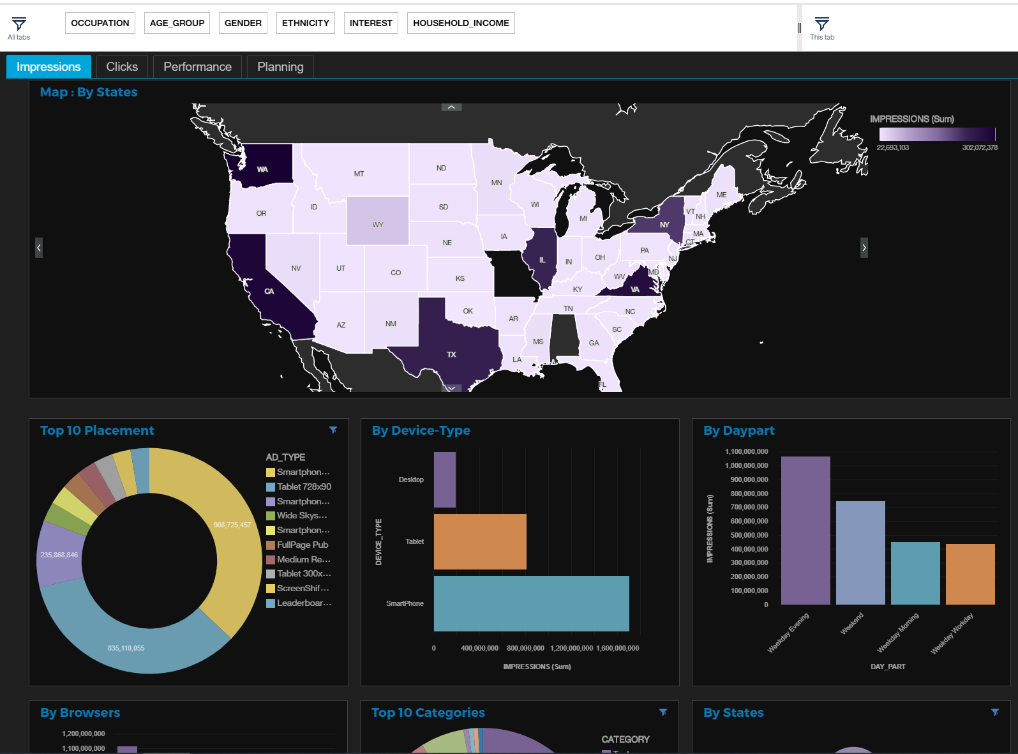
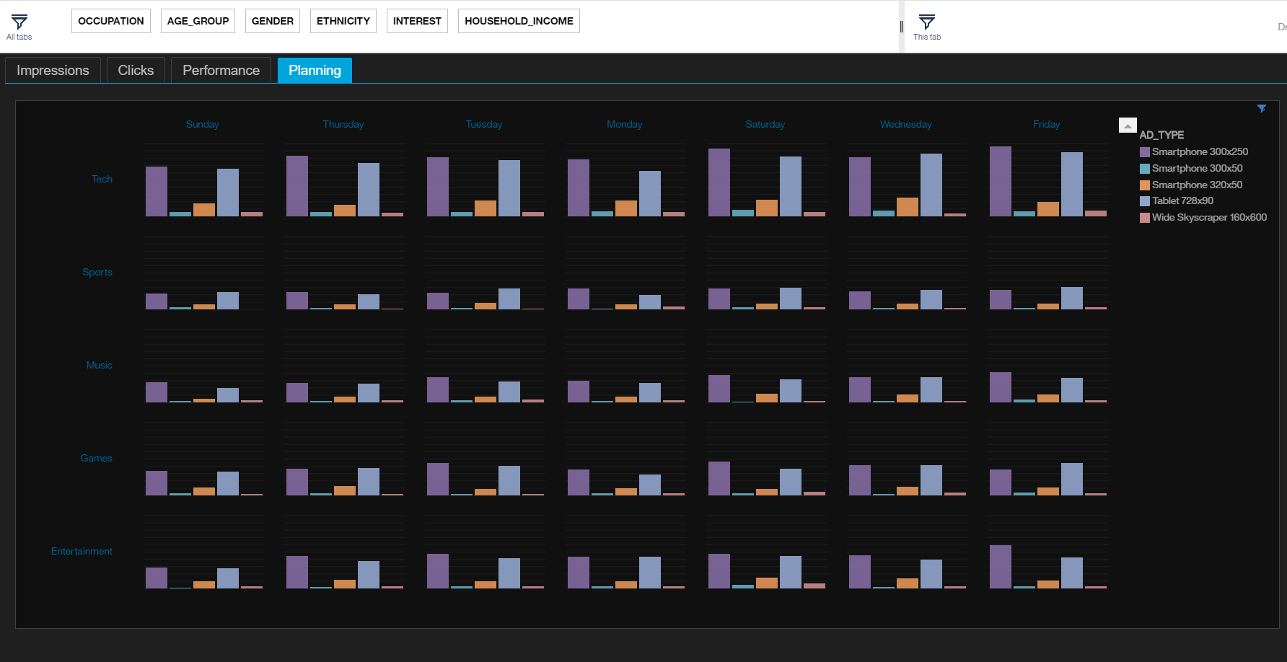
Media Ad Analytics Screenshot

Slide 9
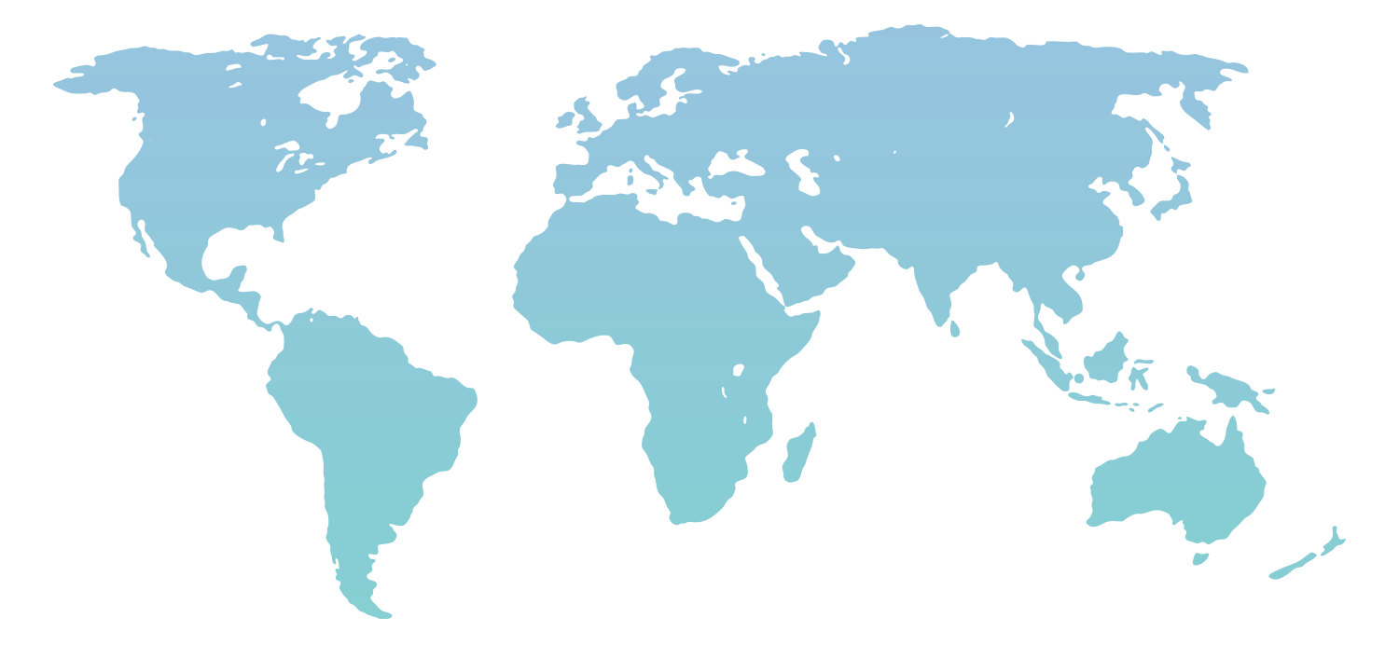
Tavant AT a Glance
OUR VISION
Indianapolis
London
Tokyo
“To be experts in each market we enter, offering unquestioned value and extraordinary service to achieve mutual success and growth for our employees, customers & shareholders”
Santa Clara Headquarters
Dallas
New Jersey
Noida
Canada
Hyderabad
Kolkata
OUR FOCUS
Colombia
Bangalore
Innovation and domain expertise driven technology leadership
Evolving needs of consumer buying behavior and operational excellence
Sydney
Silicon Valley
Headquarters
2500+ Employees
7
Countries
2000
Year of Inception

Slide 10









Media
Offerings
10+ years
COEs
TVOT Show 2019
NAB Show 2019
Advanced Advertising Summit
NYC TV WEEK 2019
Enabling companies manage, distribute & monetize content
OTT
Video Content Management
Broadcast
Customer Analytics
Mobility
Content Monetization
Digital Media
Advanced Analytics
Data Analytics
Advanced Advertising
Digital Broadcasting
Media Operations
Data Analytics
Advanced Advertising
Digital Broadcasting
Media Operations
We work with
8 Companies from Fortune 100
Global Leader in the DVR space
2 of the Top 5 Media Companies in the US
Leading Radio Broadcasters
Artificial Intelligence
and
Machine Learning
Sub Segments
Broadcasting
Publishing
Advertising
Sports & Entertainment
New Media
Gaming
Products, Frameworks &
Strengthening Partnerships
Media Planning and Sales Management
Viewership Analytics Platform
Video Testing Automation Framework
Dev Ops Frameworks
Adobe, Kaltura, Kentico, Salesforce, Apigee, Amazon Web Services, Cloudera, Microsoft Azure
LATEST AT TAVANT MEDIA

